Slide 1

Expense tracker
IDP FINAL YEAR PROJECT
Guided By : Dr. Nimisha Patel
Presented by :
PARTH DESAI – IU1841230011
YASH KAKRECHA – IU1841230022
MANAV PRAJAPATI – IU1841230045

Slide 2

Exploration and Analyze
- In today’s world, almost everything is shared. Be it a casual dinner or your apartment rent.
- This often arises the question of splitting the bill evenly which, as we all know it, isn’t the most pleasant experience.
- Hard to keep track of debts, even tougher to calculate the expense.

Slide 3

Definition
- Expense Tracker, is a systematic web application which helps to maintain and analyze your personal as well as collaborative expenses.
- Splits expenses with your friends and family.
- Keeps the track of various bills and gives genuine calculated output.
- Here's a quick overview of how it works.

Slide 4
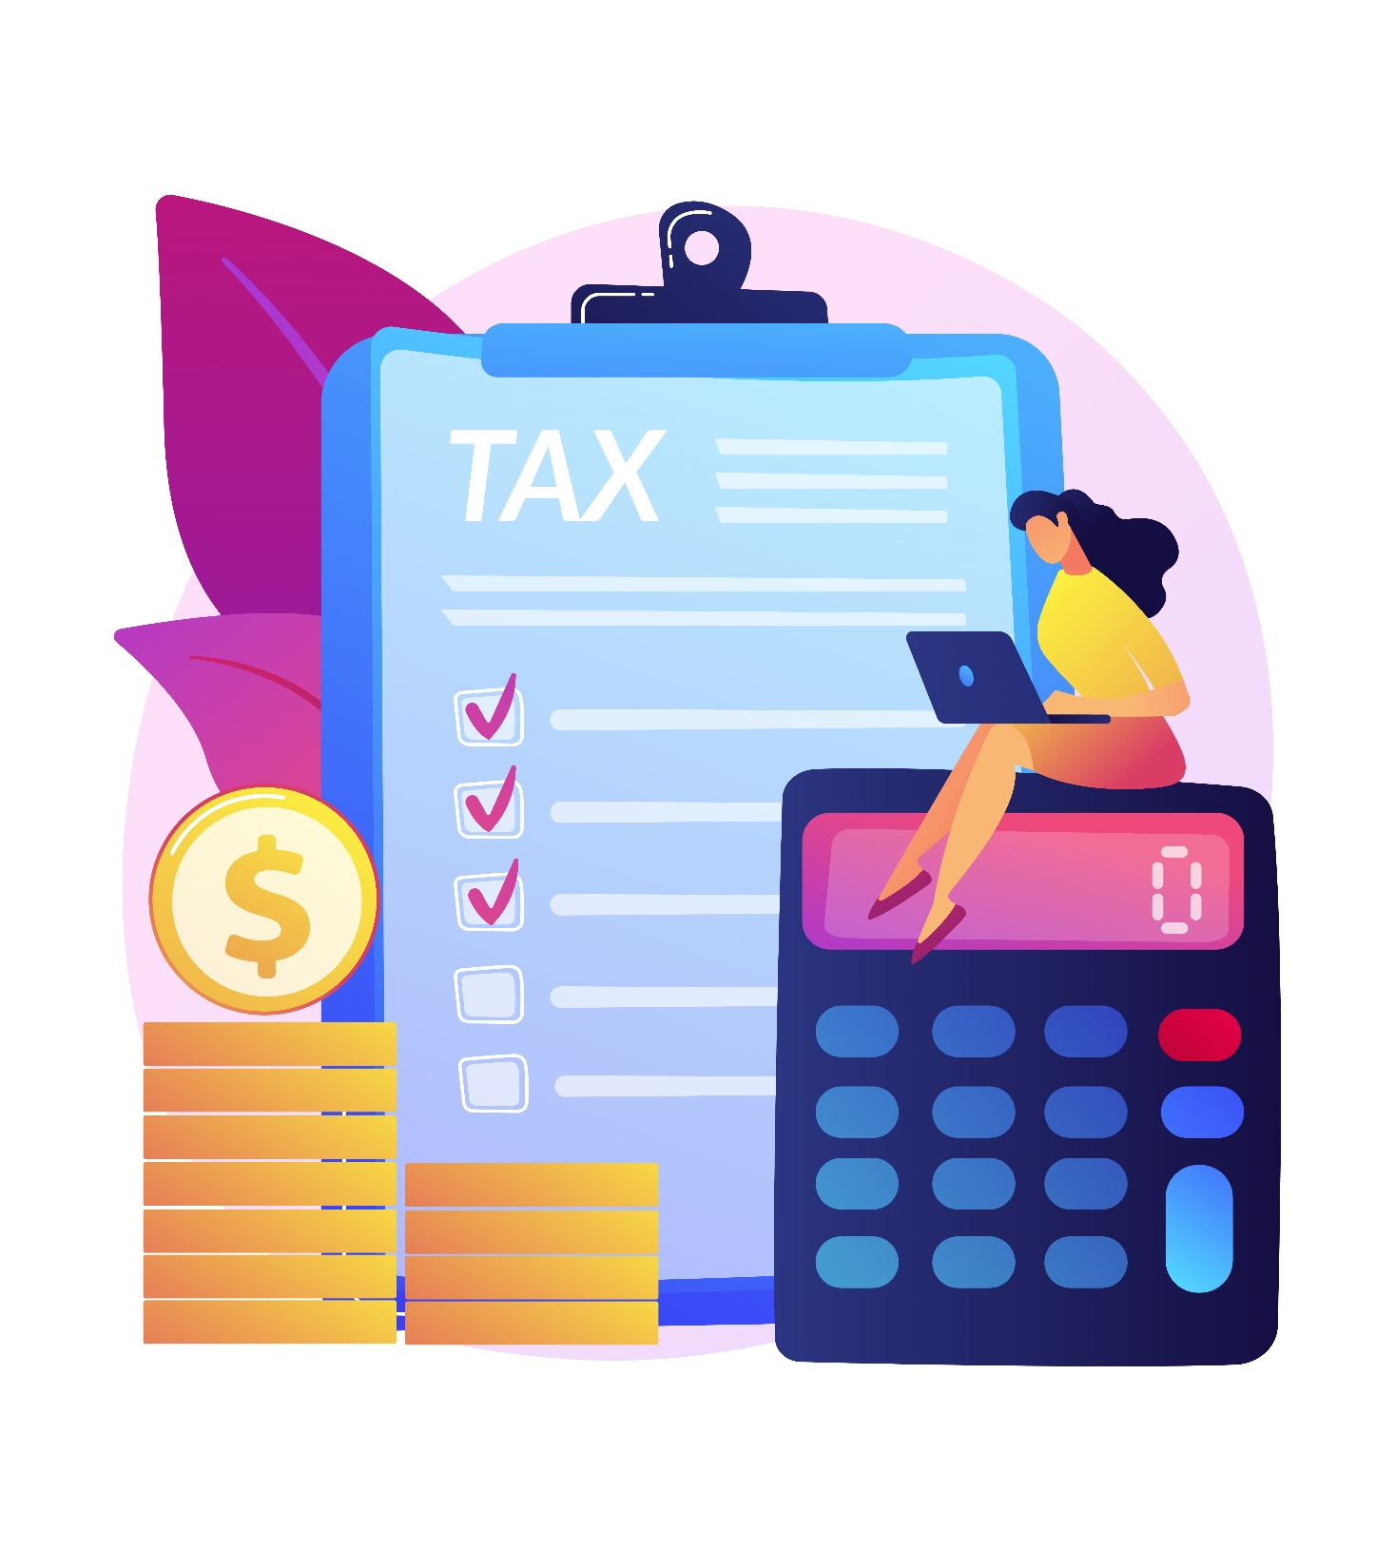
objectives
- To keep an accurate record of your money inflow and outflow.
- Provide an up to date track of all the debts among the members.
- It will make the splitting process transparent and error free.
- To get rid of unnecessary confusion about spliting your expense.
- To keep a record for financial goals of user, so it becomes easy to spend money wisely.

Slide 5

Thank you

